Slide 1

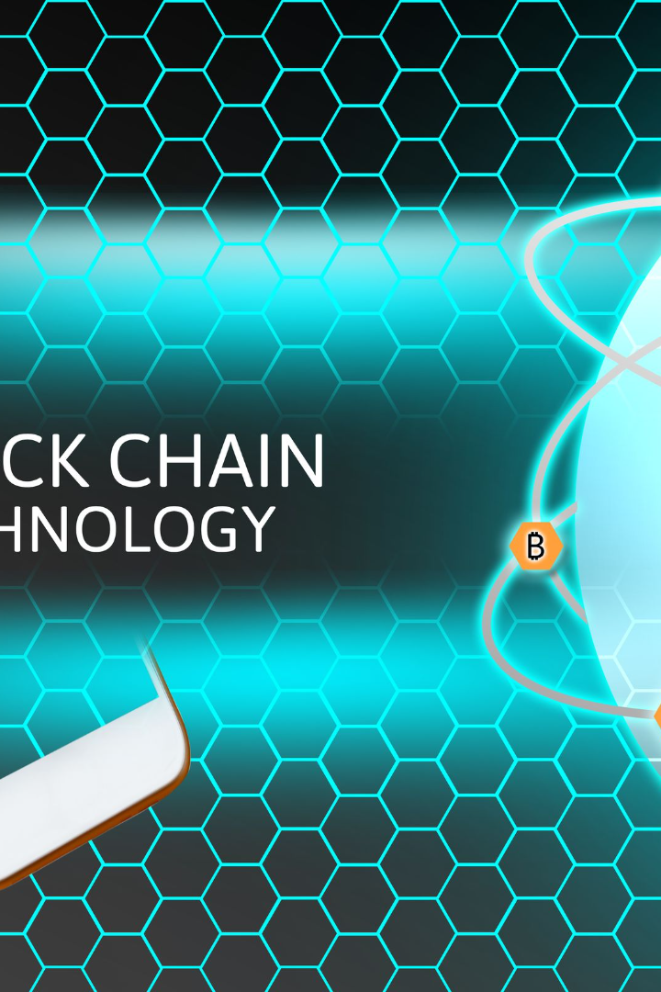
Creating a Freelance Job Posting dApp on Solana Blockchain
Welcome to our presentation where we unveil our solution for the challenge of creating a job posting dApp on Solana Blockchain. We'll show how we went from a problem to a working solution with impressive results.
wX
by wang

Slide 2
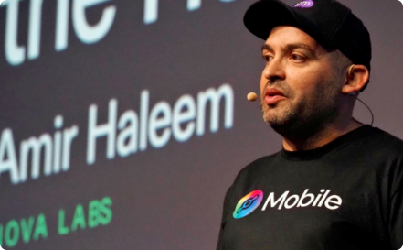

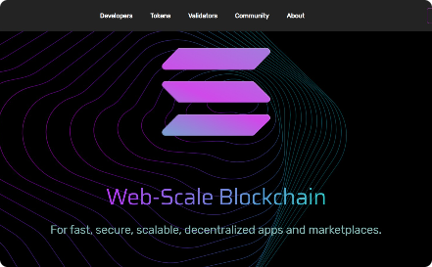
Exploring Solana Blockchain
What is Solana?
How Solana works
Why Solana?
Solana is a high-speed and secure blockchain platform that supports decentralized application development, smart contracts, and more.
The network uses a unique consensus algorithm called Proof of History for efficient block validation and scalability, as well as Validators who confirm transactions on the network.
Solana provides unbeatable speed, affordable fees, and high scalability, making it a top choice for building dApps.

Slide 3
Challenges in Creating a Job Posting dApp
1
Scalability
Traditional centralized systems cannot handle the traffic generated from the high demand in freelancing platforms.
Security
2
Ensuring the data privacy and authenticity of freelancers is essential in maintaining transparency and trust in the platform.
3
User Experience
Creating a simple, effective, and user-friendly interface to help users navigate the platform and perform tasks easily.

Slide 4
Solution: Building a dApp on Solana
Improved Efficiency
Decentralization
Enhanced User Experience
The Solana platform's fast transaction processing speed can support a massive number of users, thereby providing an efficient job posting platform.
Blockchain technology guarantees that the application runs in a transparent and decentralized environment, ensuring fairness and security for all.
The innovative features on our Solana-based dApp makes job posting easy, seamless and cost-effective.

Slide 5
Competitive Analysis
Our dApp
Competitor A
Competitor B
Scalability
Highly Scalable
Scalable
Non-scalable
Security
Secure and decentralized
Secure
Decentralized
Transaction Fees
Low fee structure
High fee structure
High fee structure
User Experience
Intuitive and simple UI
Complex UI
Simple UI

Slide 6
Technical Proposal
1
Stack:
We propose building our dApp using Solana for the blockchain layer, React for the front end, and Rust for the smart contract.
Features:
2
Our dApp will include features such as profiles of freelancers, job postings, smart contract integration for secure payments, messaging, and arbitration
3
UI Design:
The dApp's UI will have a modern and appealing design that is easy to use, with seamless integration into the Solana blockchain.

Slide 7

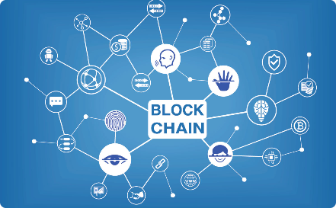


Project Plan
Phase 1 - Planning
Phase 2 - Development
During this phase, the team will define the project's objectives, scope, requirements, and budget.
The blockchain and smart contracts will be coded & tested, while the UI is designed & developed.
Phase 3 - Testing
Phase 4 - Launch
The developed dApp will undergo various tests & bug fixes to ensure quality and smooth operation.
The dApp will be published to the Solana Mainnet to enable a wider audience to use it.

Slide 8
Features of the dApp
Freelancers Profile creation
Job Posting
Users will be able to create a profile and showcase their skills & expertise.
Employers will be able to post jobs and engage with freelancers through the platform.
Smart Contracts
Messaging System
Secure payments are integrated into smart contracts, which are escrowed until work is completed satisfactorily.
Both freelancers and employers can message each other and maintain communication throughout the hiring process.

Slide 9

Expected Results
1
High Efficiency and Scalability
2
Secure and Transparent
The blockchain-based platform will ensure complete security and transparency regarding user details and payment processes.
The Solana-based platform will provide high efficiency and scalability to ensure a smooth and stable user experience.
3
Improved User Experience
The platform will provide an easy-to-use, intuitive interface with fast and seamless payment processing at low fees.

Slide 10

Contact Our Team
We are dedicated to making sure our dApp provides the best user experience in the market. Contact us at team@dapp.com to get involved or learn more.

Slide 11

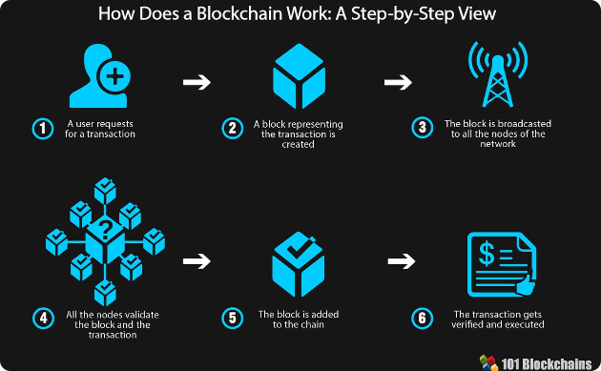
Conclusion and Future Prospects
Immediate Future
Long-term Future
We plan to take our platform to a wider audience and build a thriving community of freelancers and employers.
We hope to see our dApp become one of the most efficient and secure platforms for freelancers' job postings with more features for a better experience.

